Slide 1

TOPIC-Operating System
COURSE: CCC Concept
CHAPTER: 01 (Operating System)
DAY: 8
NIELIT
Presentation By :Shruti Dubey

Slide 2
Introduction to Operating System
10 Best Operating Systems In Market
MS-Windows
Ubuntu
Mac OS
Fedora
Solaris
Free BSD
Chrome OS
CentOS
Debian
Deepin

Slide 3
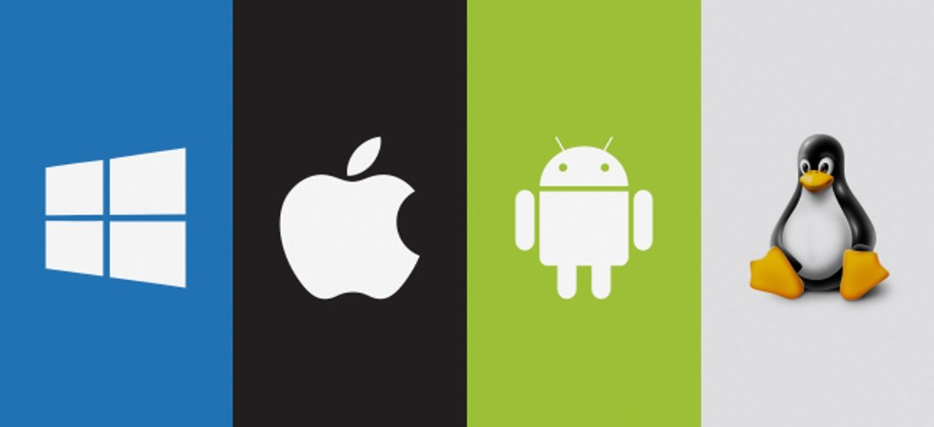
Operating System for Desktop and Laptop
Five of the most common operating systems are Microsoft Windows, Apple mac OS, Linux, Android and Apple's iOS.

Slide 4
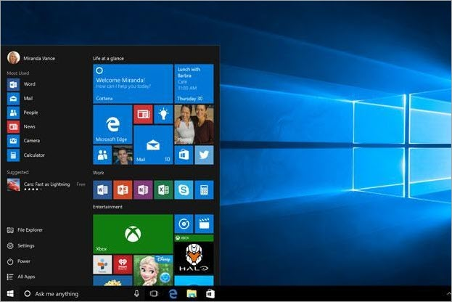
Introduction to Operating System
MS-Windows
Best For Apps, Browsing, Personal Use, Gaming, etc.

Slide 5
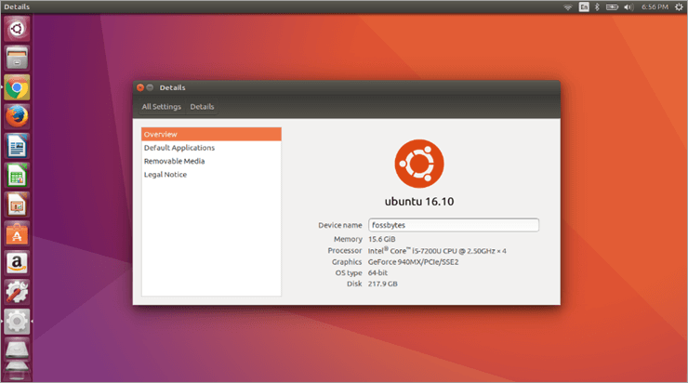
Introduction to Operating System
Ubuntu (Linux)
Best for Open Source Downloading, Running Apps, Browsers, and Gaming.

Slide 6
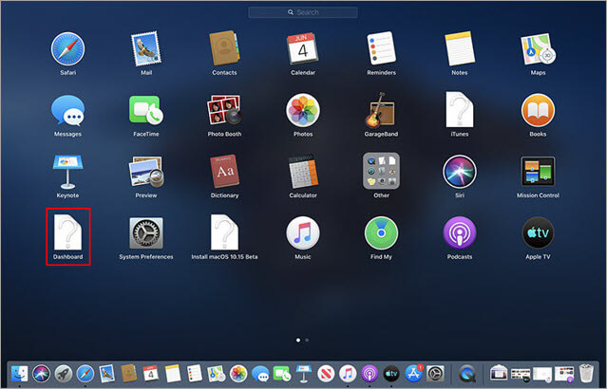
Introduction to Operating System
Mac OS
Best For Apple-exclusive Apps, Dynamic Desktop, etc.
Features
The new dark mode gives your desktop interface a more dramatic look which is easier on the eyes.
A dynamic desktop which helps to automatically organize your desktop files by kind, date or tag.
Continuity camera that scans or photographs a document nearby your iPhone and automatically appears on your mac.
Discover handpicked apps with the MAC app store.
New iTunes that allows users to search for songs with few lyrics.
Prevent websites from tracking your Mac by making your profile more anonymous online.

Slide 7
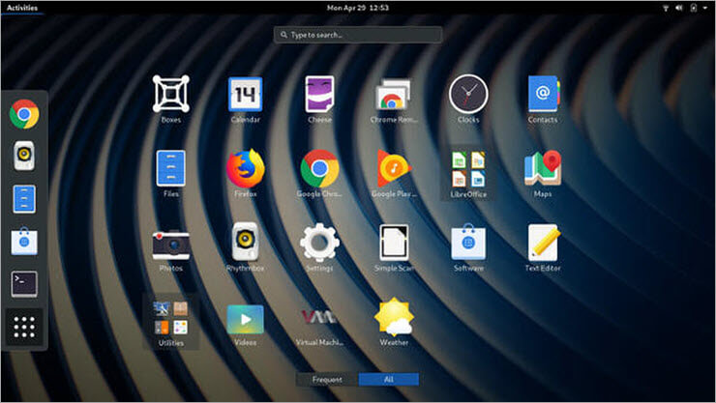
Introduction to Operating System
Fedora
Best For Open Source Development, Corporate Use, etc.

Slide 8
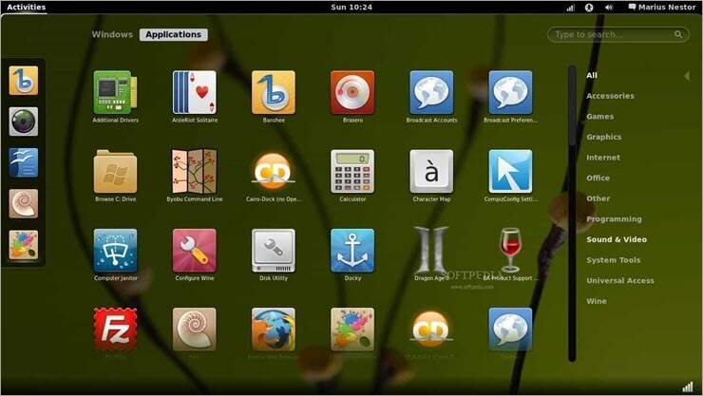
Introduction to Operating System
Best for Large workload processing, managing multiple databases, etc.
Solaris

Slide 9
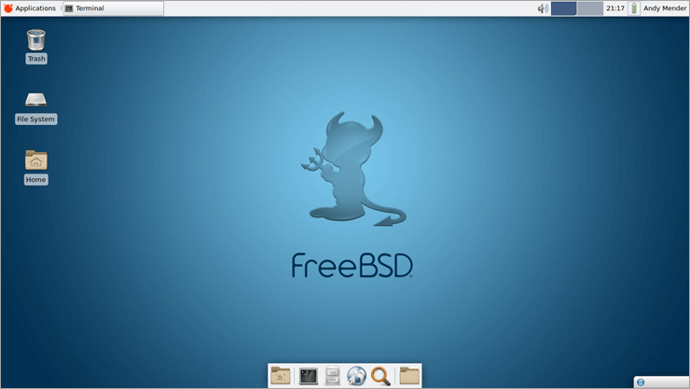
Introduction to Operating System
Free BSD
Best For Networking, Internet and Intranet server compatibility.

Slide 10
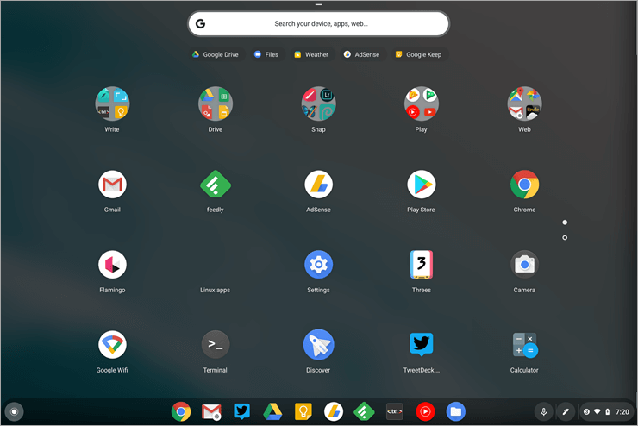
Introduction to Operating System
Chrome OS Best For a Web application.

Slide 11
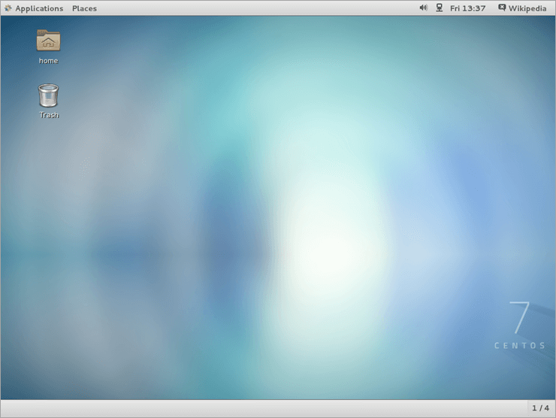
Introduction to Operating System
CentOS Best for Coding, Personal, and Business Use.

Slide 12
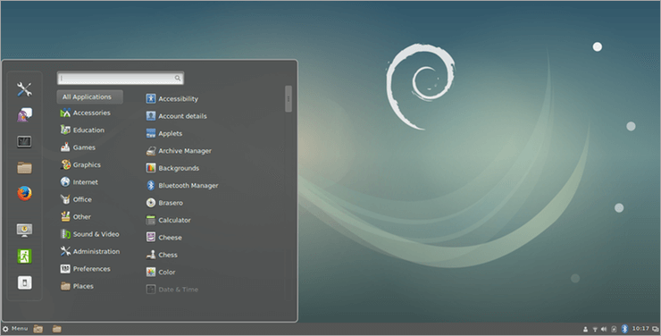
Introduction to Operating System
Debian Best For Running Apps.

Slide 13
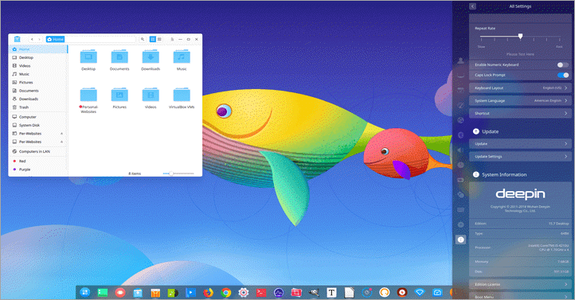
Introduction to Operating System
Deepin Best For Running Application.

Slide 14
DOS features
Among the features and limitations of disk operating systems are the following.
Features
Command-line interface (CLI). It does not have a GUI and doesn't accept mouse inputs. It is a character-based interface system where all commands are entered in text at the command- line prompt.
Management. A disk operating system can manage a computer's files, I/O system and its memory.

Slide 15
DOS features
Limitations
No built-in security. It does not have built-in security, such as file ownership and permissions.
No multiusers or multitasking. It also does not support multiusers or multitasking. It is only able to run one program at a time, but it provides direct access to the basic I/O system and underlying hardware.
Challenging interface. The CLI, in which a user must type in commands, requires the user to remember commands to run programs and do other OS tasks. This approach makes it difficult for novices to use. For example, typing the command cd \directory_name changes the current working directory to the named directory and typing the command dir lists the files in the current directory.
Common DOS commands
MS-DOS is not case-sensitive, so commands can be typed in either uppercase or lowercase. However, other disk operating systems have case- sensitive CLIs. DOS commands include the following.

Slide 16
What is an external and internal command
In MS-DOS, there are two ways commands are executed: internally and externally. An internal command is embedded into the command.com file, and an external command is not and requires a separate file to operate.
For example, if your computer does not have the fdisk.exe file and you try using the fdisk command, you will receive a "Bad command or file name" error message. Fdisk is an external command that only works if fdisk.exe, or in some cases, fdisk.com, is present.
However, as long as MS-DOS is running, internal commands, such as the cd command, are available and do not require other files to run. Each of the commands listed on the MS- DOS help page denote if they're external or internal.

Slide 17
What is an external and internal command
Internal commands are more commonly used and important to the operation and use of the Windows operating system. By embedding them in the command.com file, they can be quickly accessed and always available in MS-DOS and to Windows when needed.
External commands are powerful. They help fix problems, improve performance, and perform other actions as well. External commands usually have higher resource requirements than internal commands. Keeping them in separate files, separated from internal commands, helps to reduce the load on Windows. They can also be added to Windows whenever needed by copying the external command's file to the computer.

Slide 18
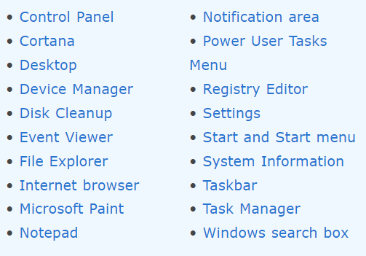
Features of Windows Operating System

Slide 19
Thank You
NIELIT

